Slide 1

Simple Linear Regression
Dustin Carrión

Slide 2
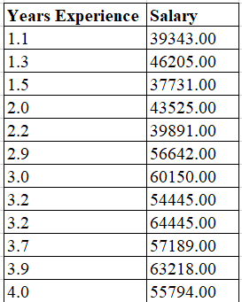
Dataset
30 Observations.
Years of experience and salary.
There is any relation?

Slide 3
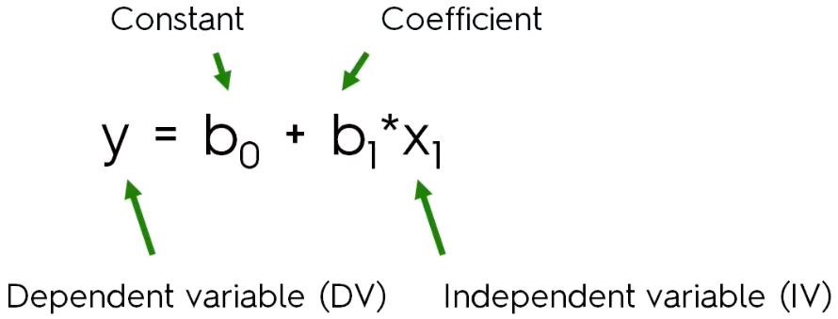
Formula

Slide 4
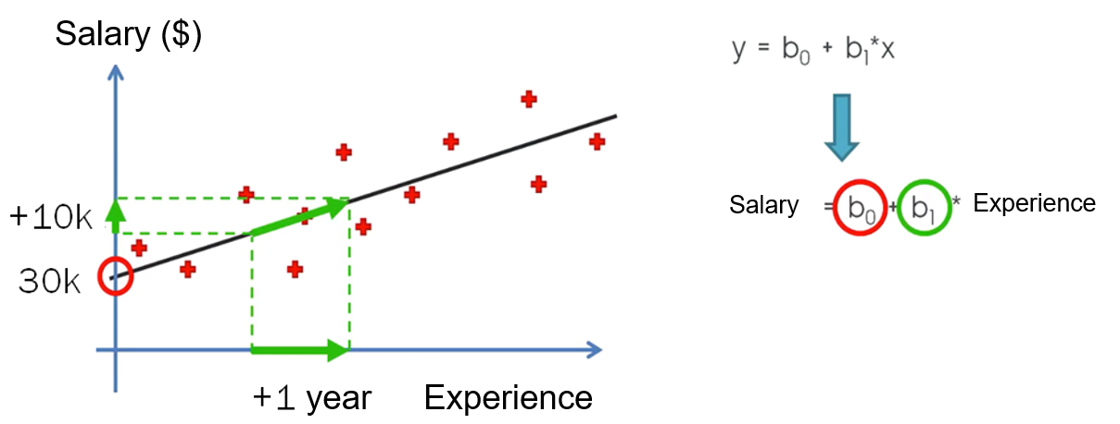
Graphic Representation

Slide 5
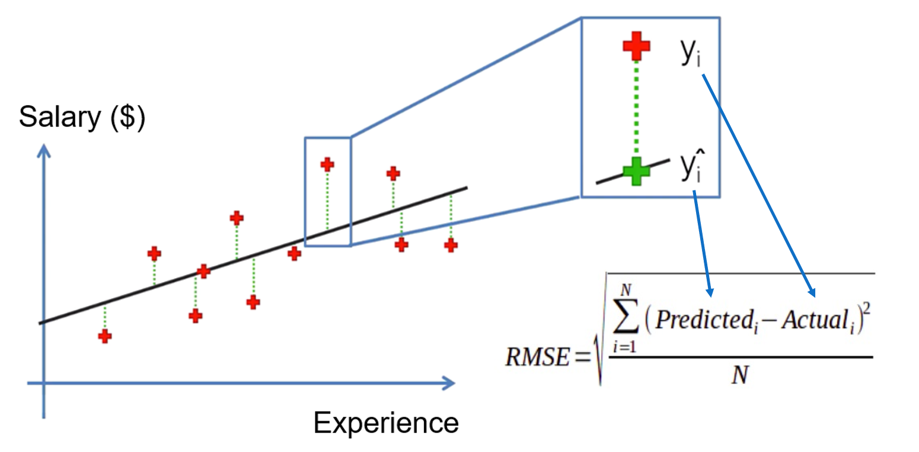
Graphic Representation

Slide 6
References
All this course is based on the Udemy course “Machine Learning A-Z™: Hands-On Python & R In Data Science” created by Kirill Eremenko, Hadelin de Ponteves, SuperDataScience Team, SuperDataScience Support.
(https://www.udemy.com/course/machinelearning/)

Slide 7

General Information
Place:
B-101
Meetings:
Tuesday 20:00 – 21:00
Facebook Group: CLUB DE DESARROLLO DE VIDEOJUEGOS E INTELIGENCIA ARTIFICIAL YACHAY TECH
GitHub: https://github.com/yachay-tech-ai

